Slide 1
Automatic Trajectory, Ball Spin and Velocity Tracking Applied to Bowling
IACV project 2023
Authors:
Aria Alinejad, Thomas Bruflot

Slide 2
Problem
Goal:
Automatically track a bowling ball and find its trajectory
Estimate spin and speed of the bowling ball
Tools:
Matlab
Iphone 11 Camera – slow motion footage 240 fps / full HD.

Slide 3
Implementation

Slide 4
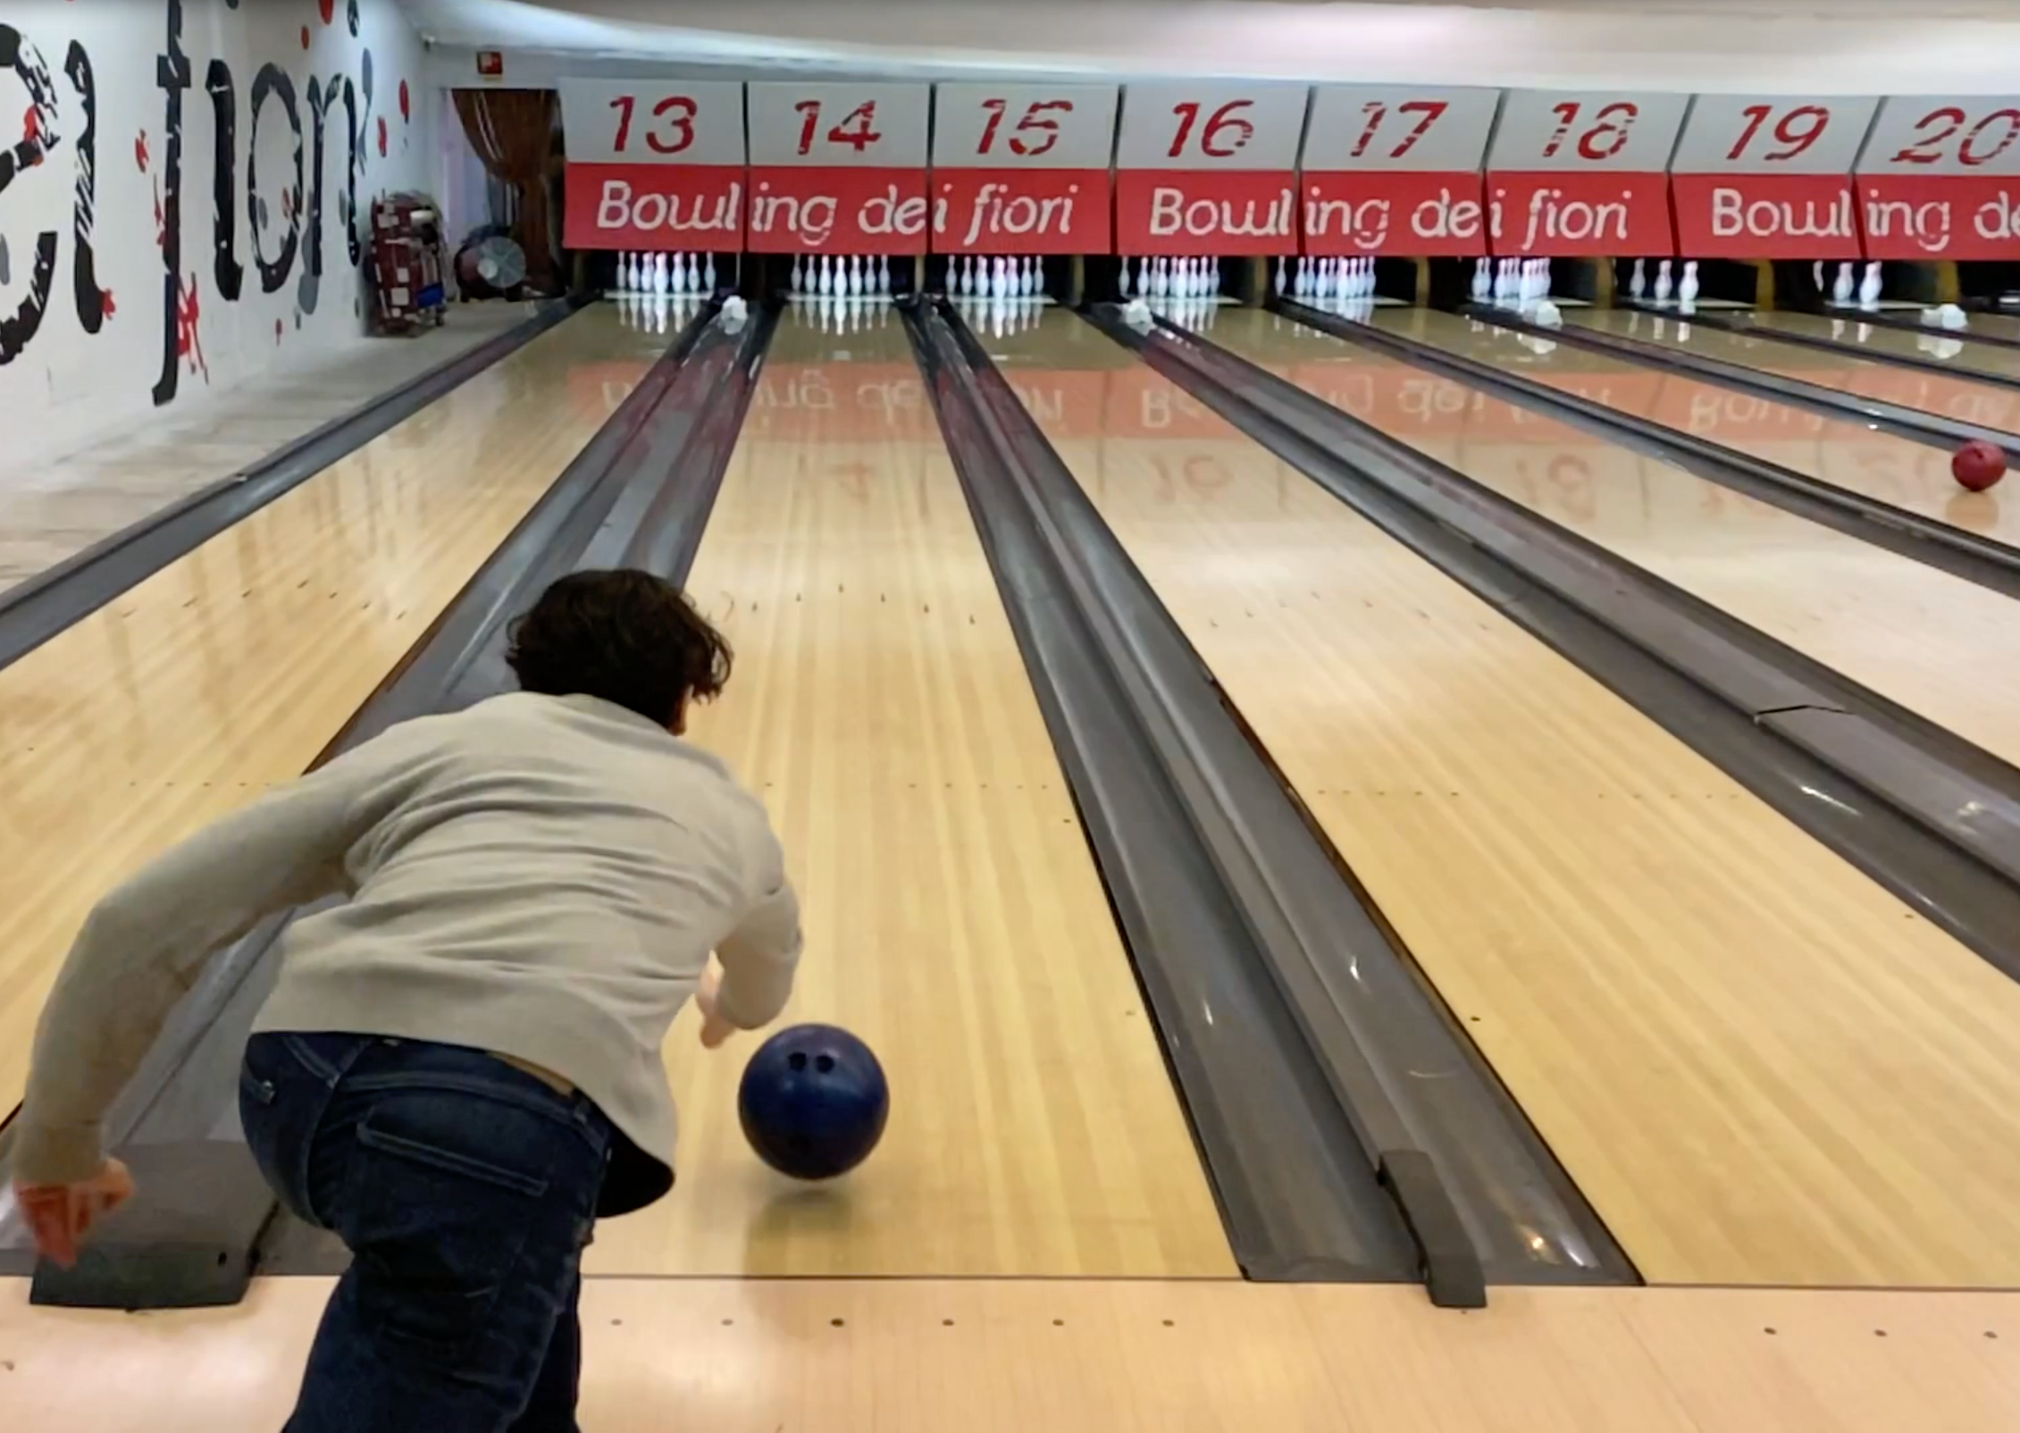
The scene
Iphone 11 1080p/240fps
Angled, centered behind the player
First line also captured

Slide 5
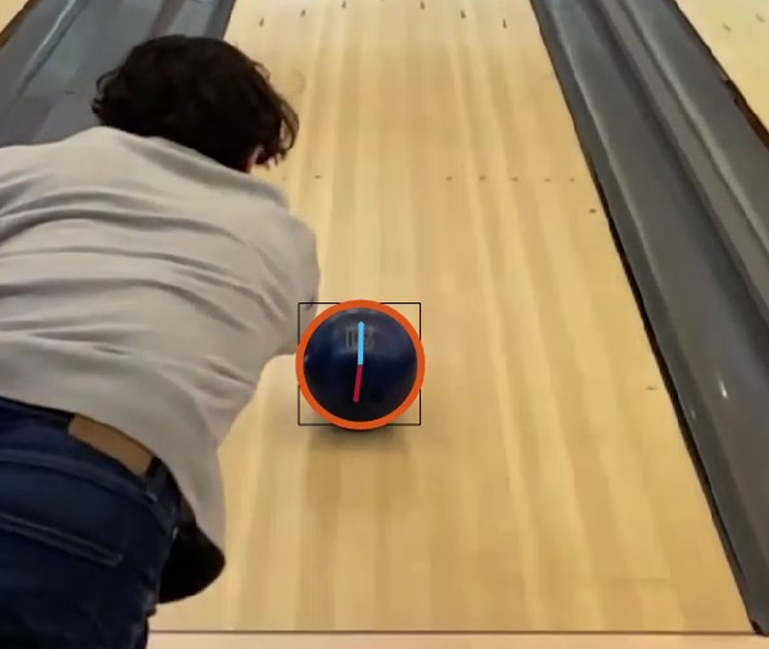
Ball detection and trajectory estimation
Circle Hough Transform
Executed on every frame
Time consuming algorithm
Applied only to part of frame – save compute
Before CHT: Adaptive histogram equalization
Fetch radii and centers

Slide 6
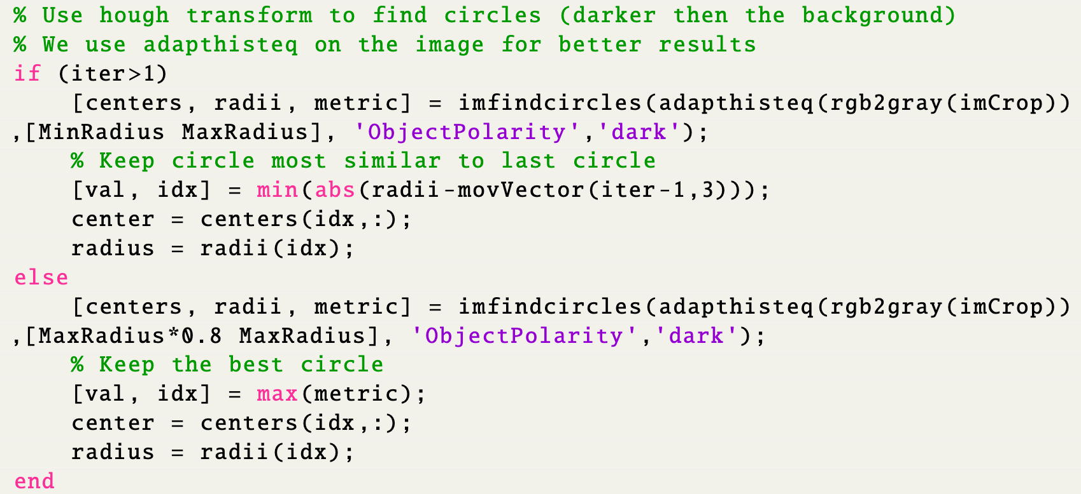

Slide 7
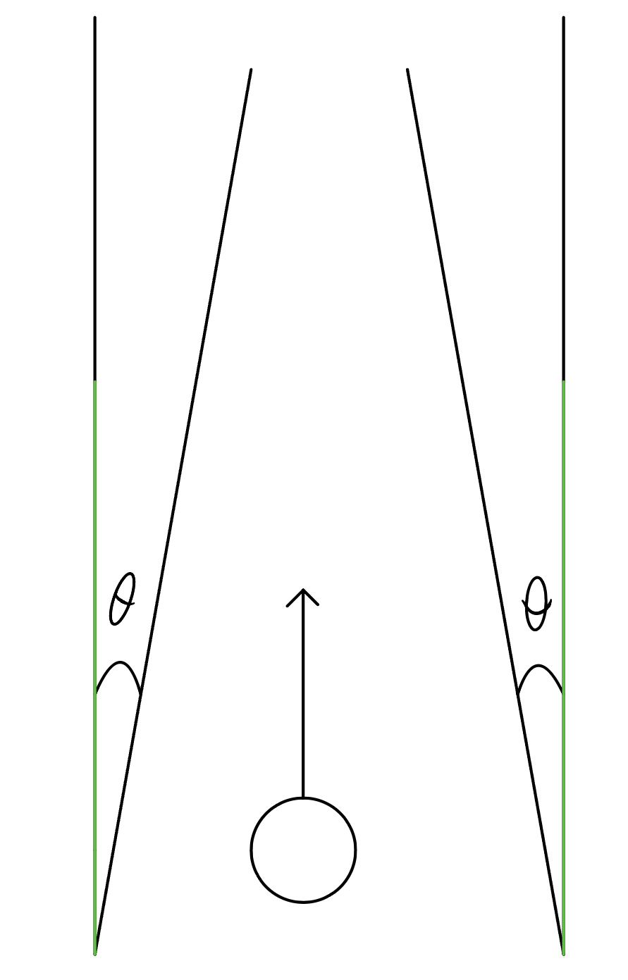
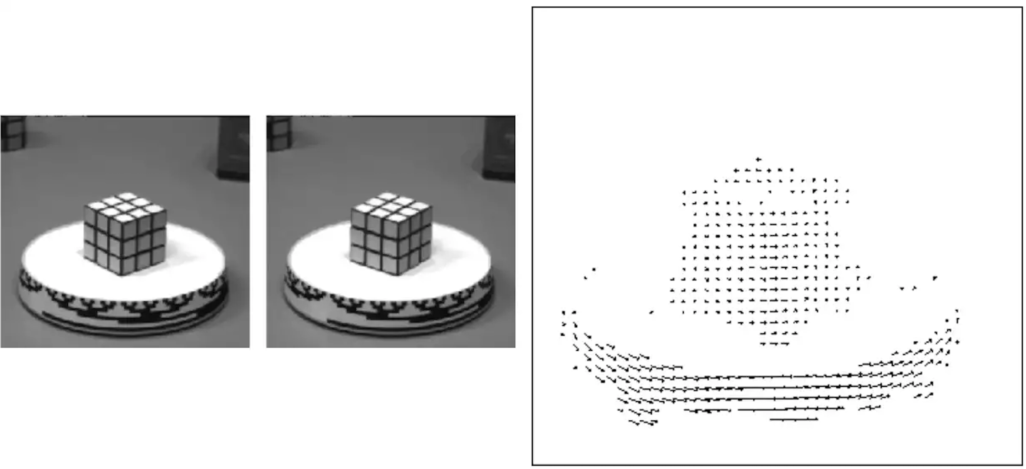
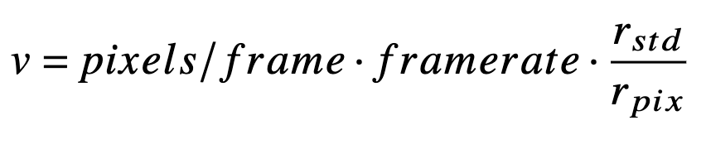
Velocity estimation
Optical Flow – Gunnar Farneback algorithm
Core idea: Rate of change from one image to another – pixels changing color
Use average from the vectors
r_std = 0.12 m

Slide 8
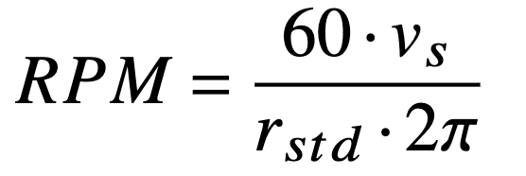
Spin estimation
Same optical flow algorithm applied to a square around ball, center of square is center of ball.
Need constant image to apply algorithm on – radii changes adaptively.
Keep only vectors in the ball mask.
Average the vectors

Slide 9
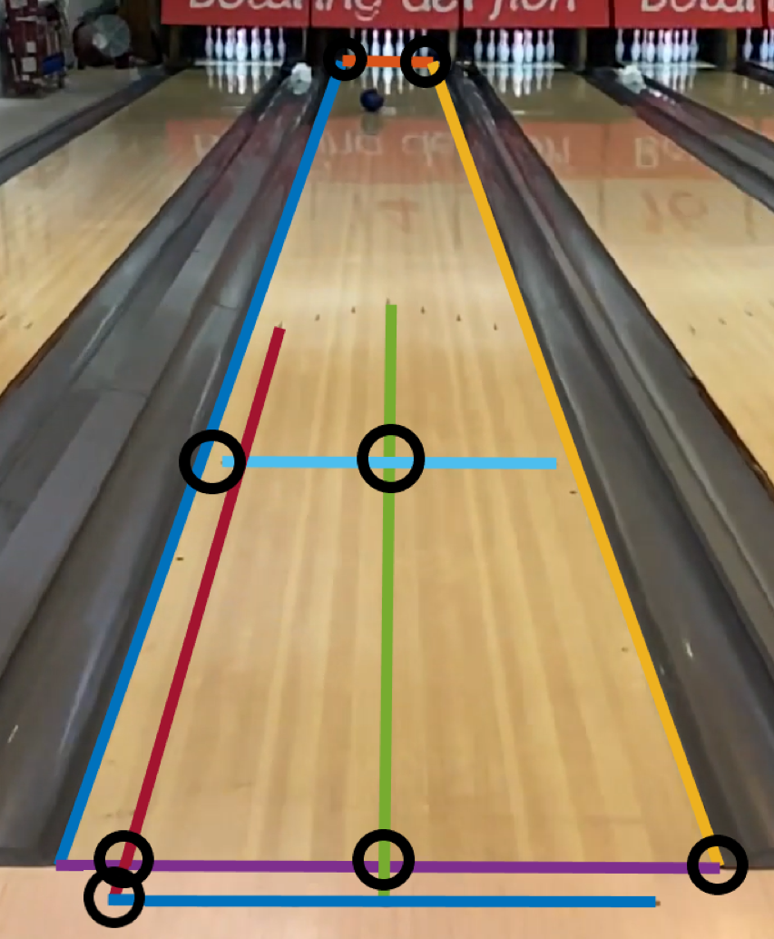
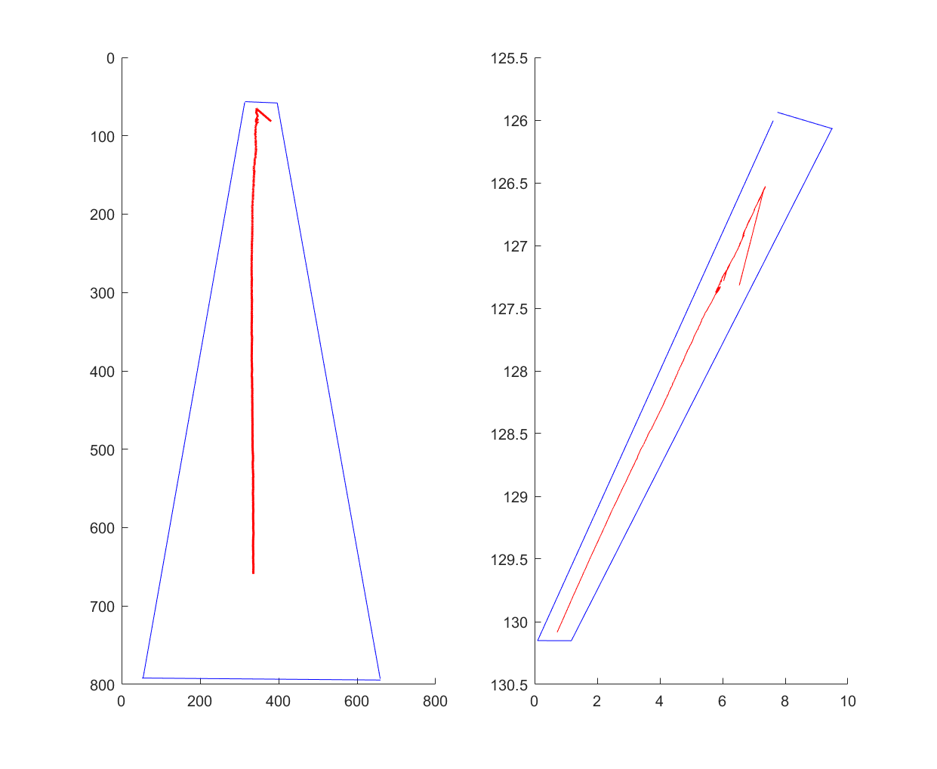
Projective transformation
To better visualize the trajectory we found a similarity mapping and transformed the trajectory in the video.
Choose 8 pairs of lines orthogonal in the real world to get 8 constraints on the image of the dual conic
Calculate a homography H –> Apply to lane and trajectory

Slide 10
Results

Slide 11
Ball detection
Good detection with small errors in radii and centers
Detected in almost all frames
Detect circle when player partially block ball

Slide 12
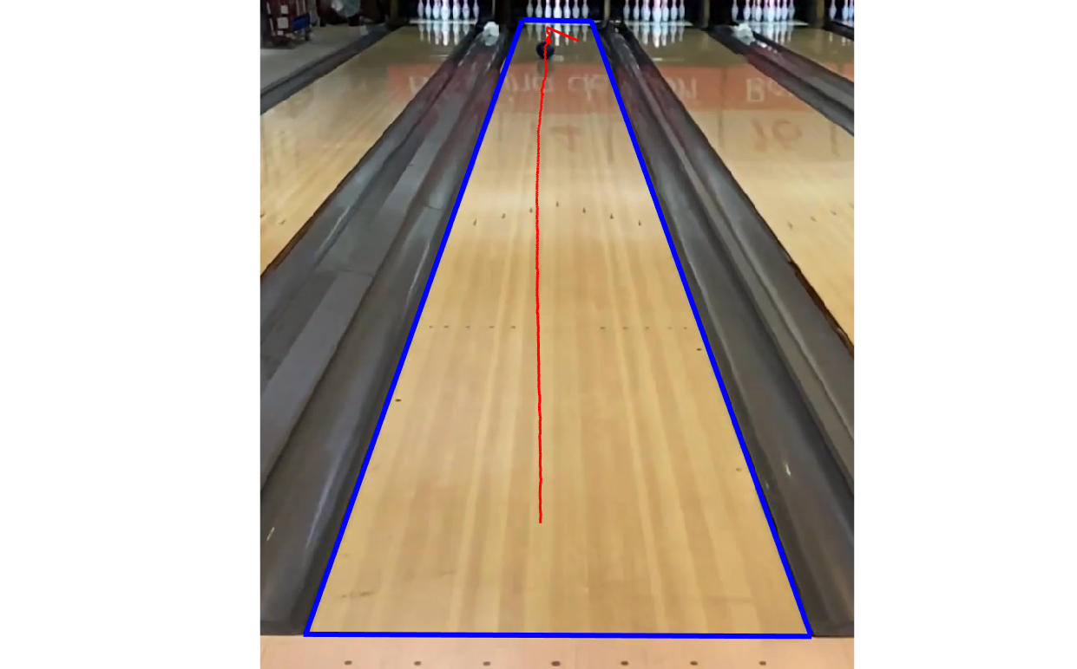
Trajectory results
Ball center and radius detected in almost all frames -> Trajectory found from center
Worse performance as ball gets increasingly smaller –> 7px in the end

Slide 13
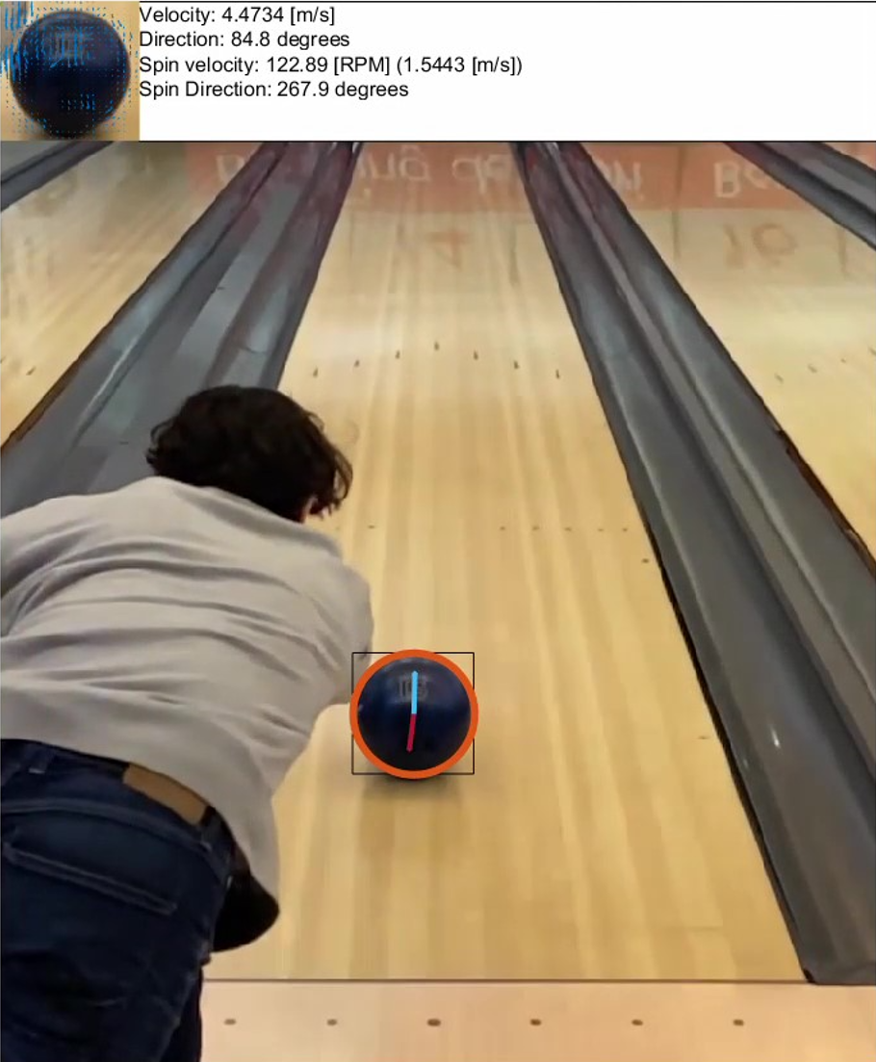
Velocity and spin
Vector directions more accurate than magnitude
Better performance with bigger ball in frame
Better formance with clear patterns on ball
Blue vector velocity
Red vector spin
Upper left: Optical flow found per frame

Slide 14
Conclusions
Successfully detected and tracked a bowling ball from a single view stationary video
Estimated direction and magnitude of spin and velocity vectors are accurate in parts of video
Visualized trajectory gives more understanding than video alone
The information extracted can be used to give a player increased insight in their play
Using a dark ball with some patterns and a high frame rate and resolution gives best results.

Slide 15
Future work
Explore neural networks and image segmentation networks for faster and more accurate detection (and tracking) of the ball
Optimize for more diverse angles, light conditions and ball colors
Add a momentum factor to the spin and velocity vectors
Measure real world spin and velocity values, and use to calibrate
Explore other spin and velocity detection methos further

